Slide 1




HackFest CDC
Mai Salah
Shahd Elhosiny
Omar Abdelazim
khaled Hany
Mostafa Lotfy

Slide 2
Health Problem
Poor Medication Management:
Healthcare Challenges in Egypt:
Most patients forget their medication appointments, which is especially harmful for those with chronic diseases.
Lack of awareness around using technology to prevent errors.
Limited resources available for home-based patient monitoring.

Slide 3
1.
Saves a lot of effort
The Importance
of the Solution
Prevents Complications
2.
3.
Cost-Effective

Slide 4
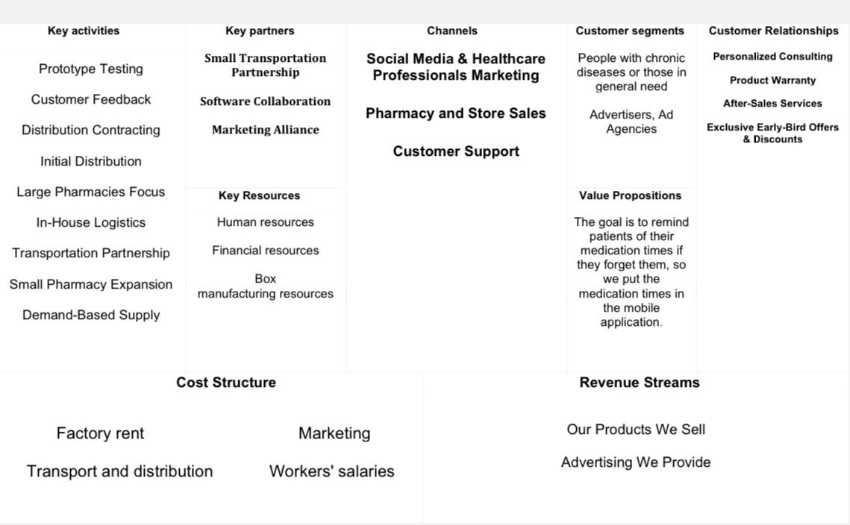

Slide 5
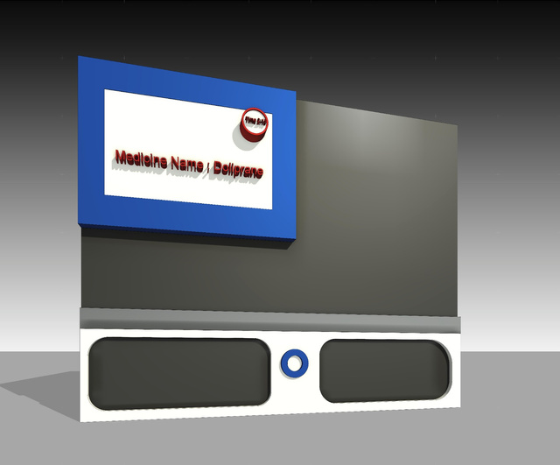

The Solution - Smart Box
Scheduled Dose Management:
Multiple Alerts:
Organizes medications by time slots (morning/afternoon/evening).
Sound notifications to remind users of medication times.
Mobile app notifications for the patient and caregivers.
Periodic Reports:
The app provides data and insights on the patient's adherence to prescribed doses.

Slide 6

Thank you
وَأَنْ لَيْسَ لِلإِنسَانِ إِلَّا مَا سَعَى ۝ وَأَنَّ سَعْيَهُ سَوْفَ يُرَى
Hackfest CDC
Dev Fest Delta

